Slide 1
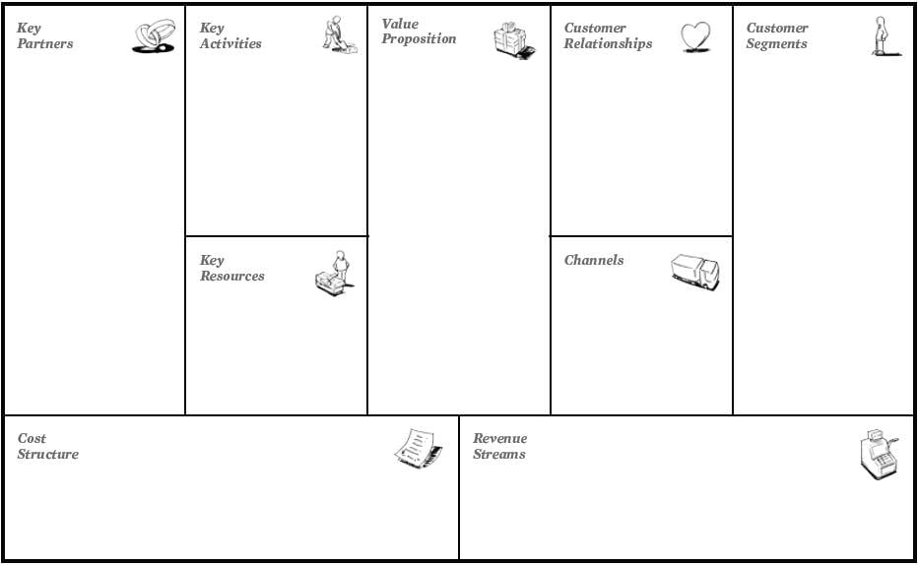
Attracting experienced trainers .
Free courses .
Paid courses .
Create a free resume for subscribes , paid for non-subscribers .
Helping or assistant video for technology student .
Free researches and book’s from AUT .
Connecting the best student in courses to training opportunities .
Awareness of IT specialization
Offering special discounts for AUT
AUT
Crown Prince Foundation
Aqaba Special Economic Zone Authority
Pioneer Academy
IT related courses
Create Cv
Interactive day
Aqaba residents .
University IT student’s .
People intrested in technology field .
Zoom
E-mail
Trainers and reseatcher .
Zoom Subscribtion
Website development .
Pay Server’s
Pay for the trainer’s
Marketing
Bank transfers , e-wallet
Pay student to trainers
Ads
Coffee house

